Slide 1
Music database
MySQL and Relational Databases
Aleksi Mutanen

Slide 2

Coolname-application
The main purpose of this app is to find similar music to your favourite genre
If you have a favourite genre in music, you can search other similar artists to discover the ones you might also like
The main target audience is music enthusiasts who actively search for new music to listen to

Slide 3
Use case
Use case 1: Searching with a genre keyword
User role: User
Goals: Successfully get a query with information about artists with the given genre
Pre-requirements: Open the application
Happy days scenario:
1. Use case start
Use case starts when the user opens the search bar
2. Give out a search word
The user types a preferred genre
3. Search the database
The app searches the database for information with the given genre
4. Present the result
The app presents the resulted information in tables
5. Use case end
The information is presented and the app is ready for another search
Alternative events:
A1/3 Search failed
The given search word doesn’t return any results
A2/3 The word doesn’t exist
The given search word doesn’t exist
A3/4 Result presentation fails
The app fails to present the information

Slide 4

User story
An user listens to his favourite band from his favourite genre. He really likes the band, but he would also like to find similar bands to that type of music. He opens the web app and types a genre name in the search bar. He gets a list of artists whose music is orientated in similar direction. He will also find additional information about band members, albums and songs.
Tämä kuva, tekijä Tuntematon tekijä, käyttöoikeus: CC BY

Slide 5
UI mockups
Insert application name here
Type to search
Search
Search criteria

Slide 6

UI mockups
Genre
Artist
Song
Album
Member

Slide 7
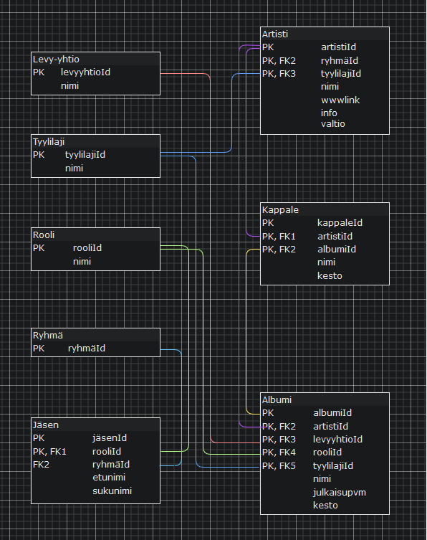
Schema

